Slide 1
Palmora Group HR Analysis Summary
Gender Equality, Salary Structure & Bonus Insights
Prepared by: HR Analytics Team

Slide 2
1. Gender Distribution
• Total Employees Analyzed: 946
• Male: 465
• Female: 441
• Unspecified: 40
• Gender breakdown provided by region and department.

Slide 3
2. Performance Ratings by Gender
• Rating categories include: Very Good, Good, Average, Poor, Very Poor, Not Rated
• Gender-wise distribution of performance shows trend insights
• Detailed view in Excel sheet: 'Rating by Gender'

Slide 4
3. Gender Pay Gap Analysis
• Average salaries computed by gender per department
• Departments with the largest disparities are highlighted
• Pay gap = difference between highest and lowest gender avg salary in each department

Slide 5
4. Salary Compliance & Pay Banding
• Regulatory minimum salary: $90,000
• Employees below threshold identified
• Pay bands grouped in $10k increments shown across regions
• Refer to Excel: 'Salary Band Distribution'

Slide 6
5. Bonus Allocation Summary
• Bonus calculated using department + performance-based multipliers
• Bonus and total pay computed per employee
• Total bonus payout and compensation summarized by region

Slide 7
Conclusion & Recommendations
• Gender distribution is relatively balanced but requires monitoring
• Some departments show notable pay disparities by gender
• Address salary compliance gaps (below $90k)
• Use performance insights to support equitable reward policies
• Dashboard and data provided in Excel for management use

Slide 8
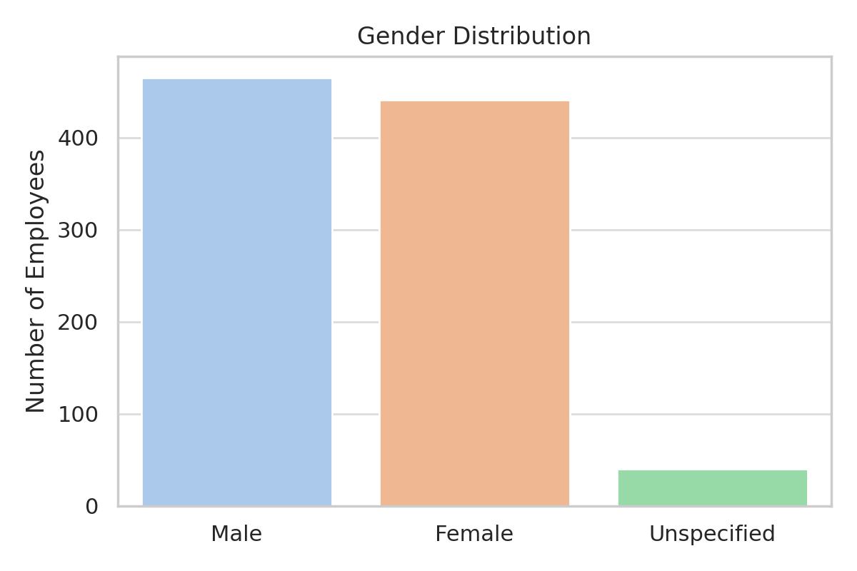
Gender Distribution

Slide 9
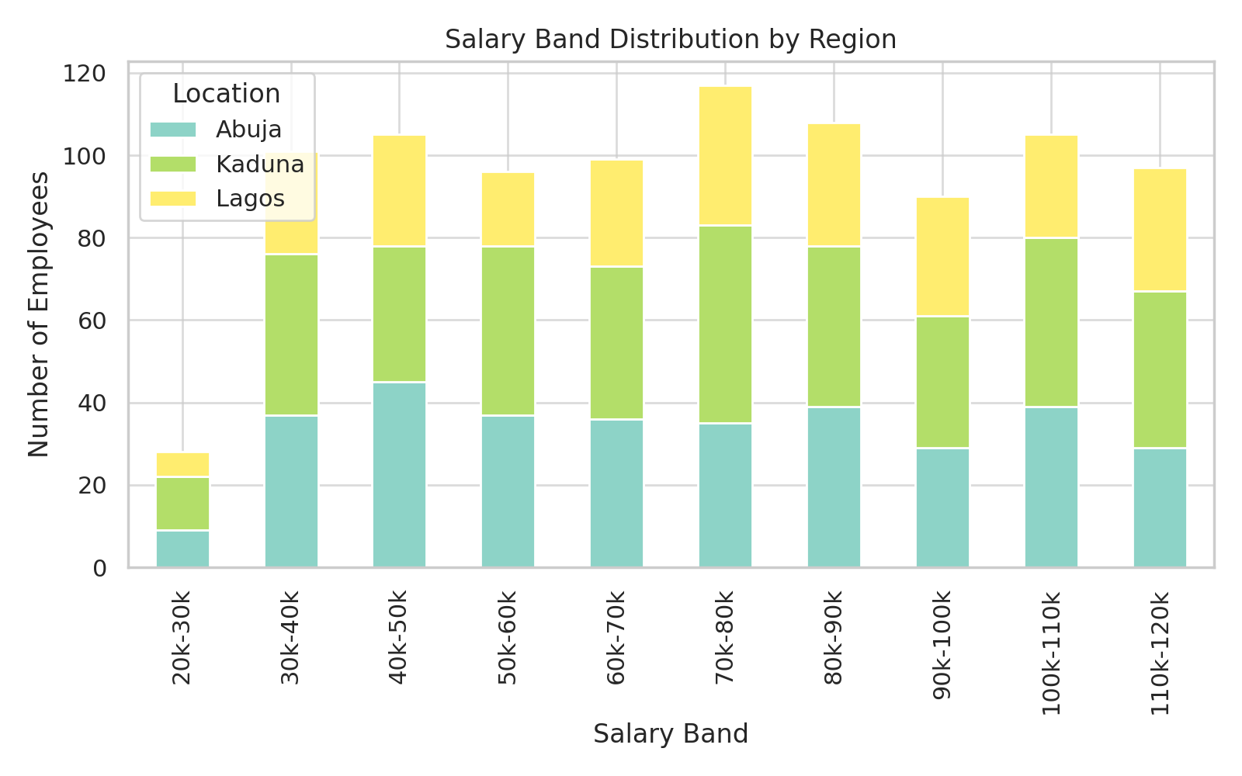
Salary Band Distribution by Region

Slide 10
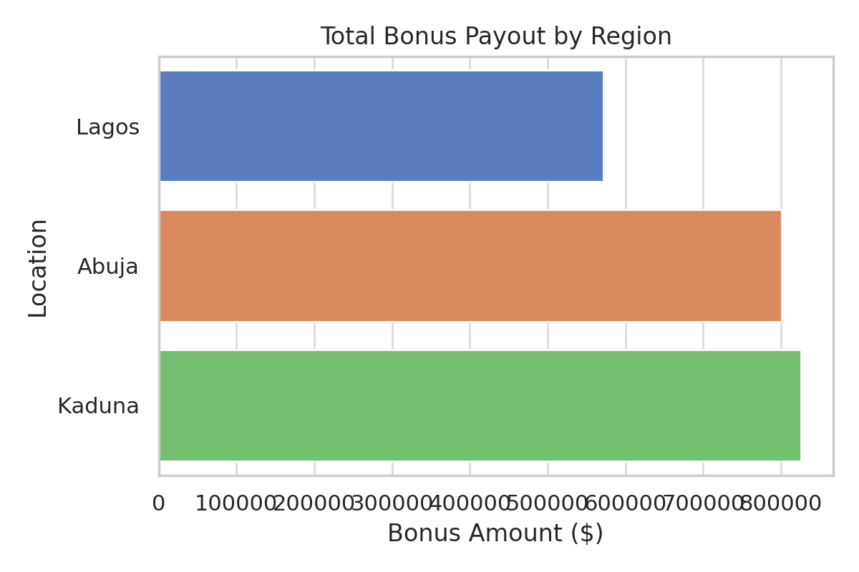
Total Bonus Payout by Region

